Slide 1
Risk Management Trends
Philip S. Renaud, II | Executive Director, The Risk Institute

Slide 2




ROOTED IN
RESEARCH
DEDICATED TO
EDUCATION
COMMITTED TO
COLLABORATION
@Risk_Institute

Slide 3
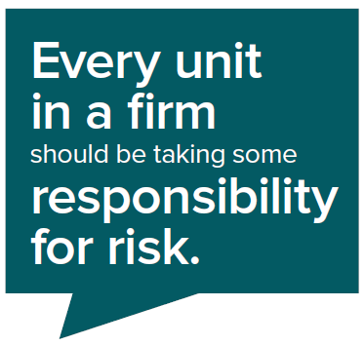

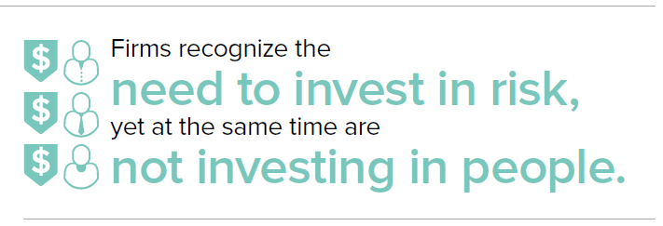
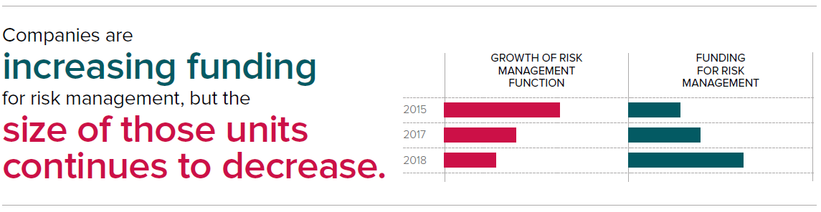
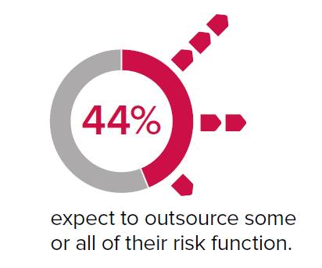
DISTRACTED DRIVING INITIATIVE
@Risk_Institute

Slide 4
2018 ANNUAL SURVEY | WHAT ARE WE LEARNING?
  70% of firms reported have an internal risk management unit!
  = 90% for financial firms/public firms;
  = 60% for nonfinancial firms;
  = 51% for private firms.

Slide 5
2018 ANNUAL SURVEY | RISK MANAGEMENT EFFORTS
  Only 18% of firms are increasing the size of their risk department.
      It was 40% in 2016 and 25% in 2017.
  Why?
  44% of firms are outsourcing a portion of their risk management to third parties.
  Think, Third Party Risk…..

Slide 6
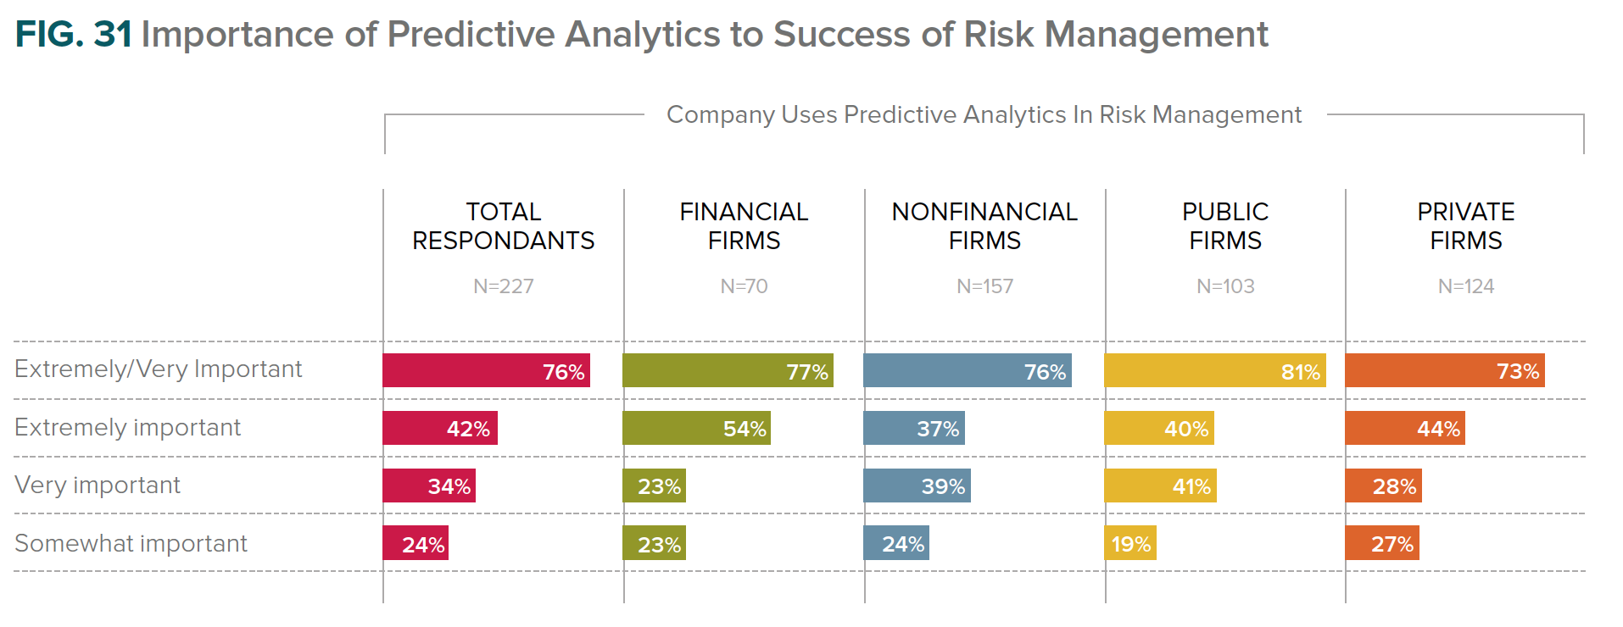
DIGTIAL RISK/DATA ANALYTICS
55% of the respondents do not use predictive analytics!

Slide 7
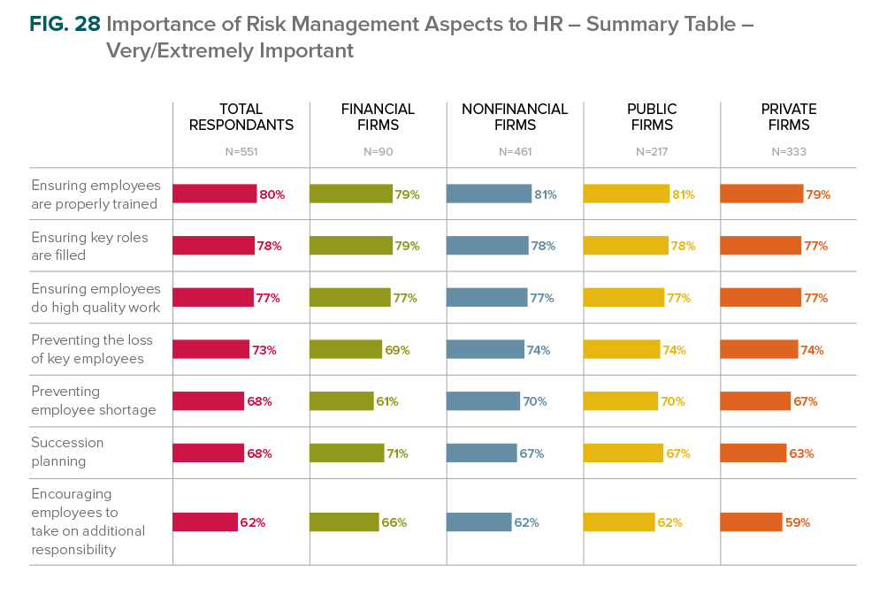
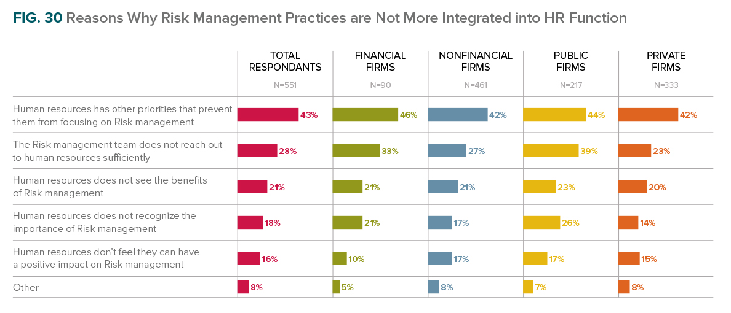
2019 ANNUAL SURVEY |
Human Resources View of Risk Management
Almost all surveyed firms will be somewhat impacted by baby boomers retiring. Customer
Service, Information Technology & Finance are the functions that will be affected the most.
About half of firms indicated that HR is at least moderately involved in the
enterprise risk management activity planning and execution

Slide 8
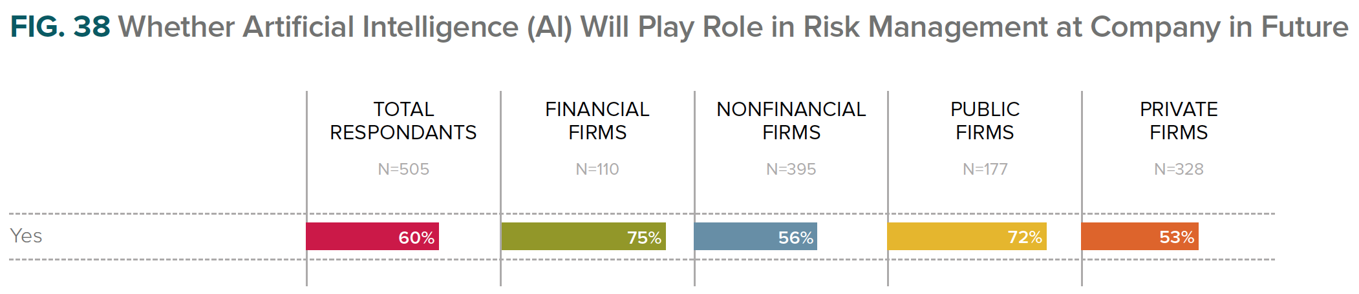
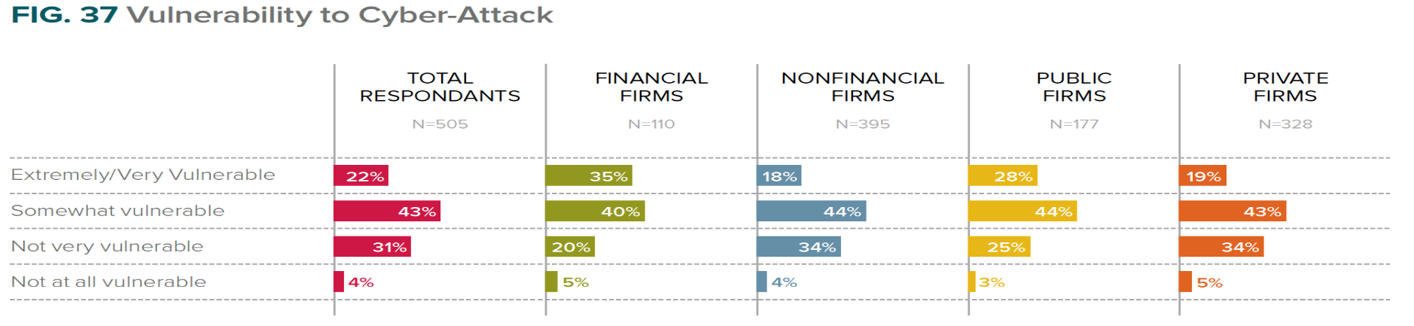
DIGTIAL RISK/DATA ANALYTICS
28% of the respondents have been a victim of a cyber attack.
65% of the respondents believe they are vulnerable to a cyber attack.

Slide 9

Warning: Turbulence Ahead
“The world is becoming turbulent faster than most companies are becoming resilient…
Few companies seem prepared for a world that is all punctuation and no equilibrium”
Gary Hamel
Resilience is the capacity to survive, adapt, and flourish in the face of turbulent change and uncertainty

Slide 10

How can companies prepare for and adapt to unexpected waves of change?

Slide 11
Black Swan Theory
The Black Swan Theory or Theory of Black Swan events is a metaphor that describes an event that comes as a surprise, has a major effect, and is often inappropriately rationalized after the fact with the benefit of hindsight.
Developed by Nassim Nicholas Taleb, to explain:
The disproportionate role of high profile, hard to predict, and rare events beyond the realm of normal expectations.
The non computability of the probability of the consequential rare events using scientific methods.
What about Third Party Risk????? Are you thinking about it????

Slide 12

Black Swans are Multiplying
Notes:
Black swan events that have never been observed and seem implausible until they actually occur.
Nassim Nicholas Taleb’s book, The Black Swan, pointed out the futility of trying to predict major disruptive events (e.g., recessions, revolutions, disasters) with cascading consequences that could change the course of our lives.

Slide 13
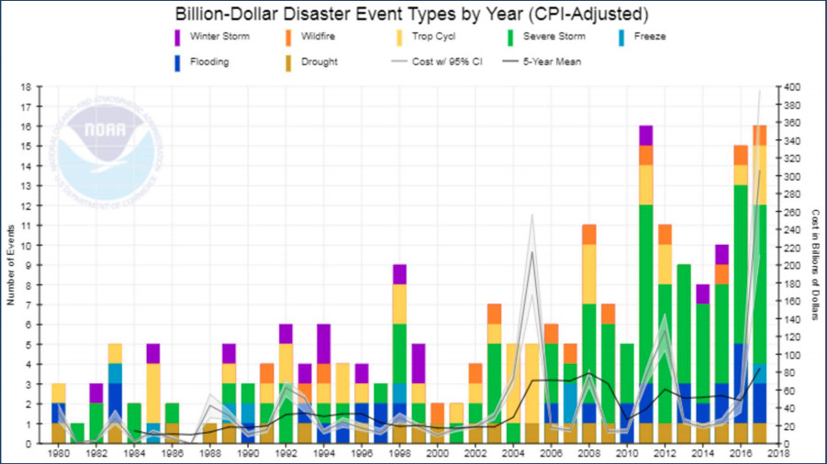
Billion Dollar Events by Type

Slide 14
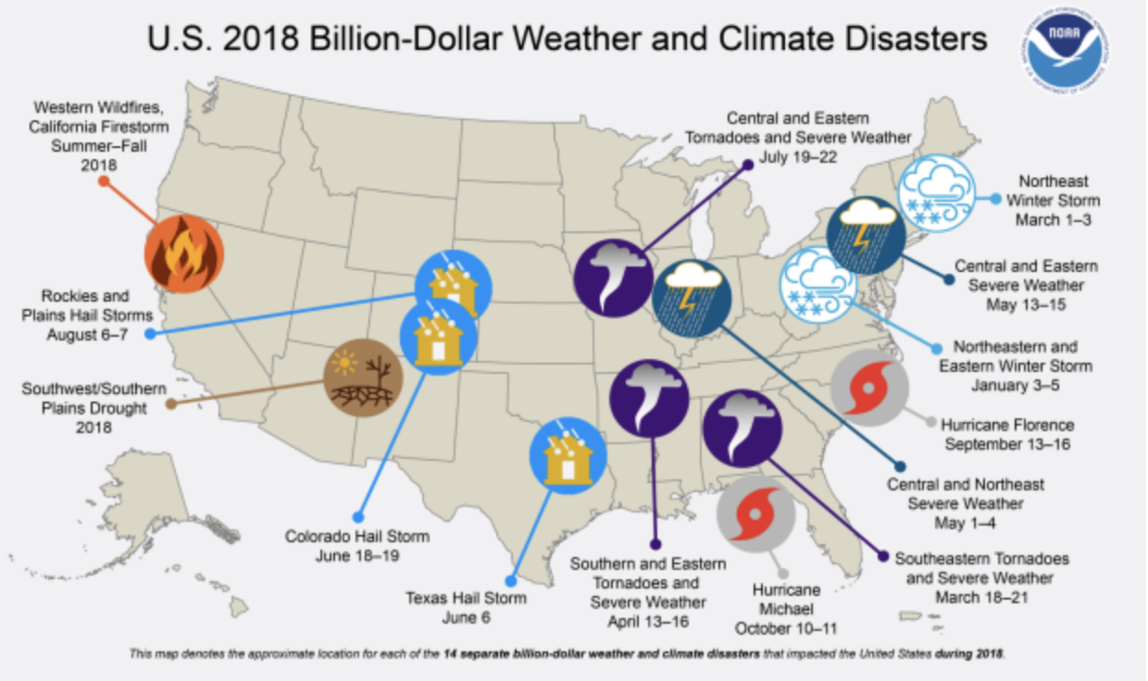
2018 Billion $ Weather and Climate Disasters

Slide 15
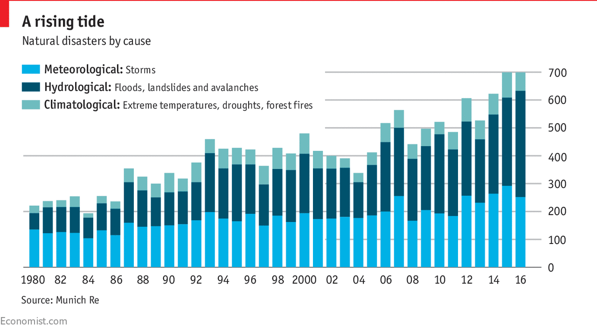
A Rising Tide…….

Slide 16
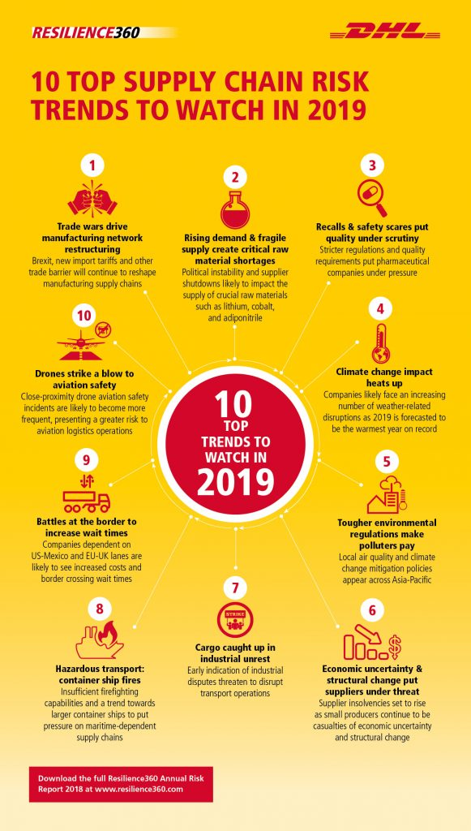
Top Supply Chain Risk Trends 2019

Slide 17
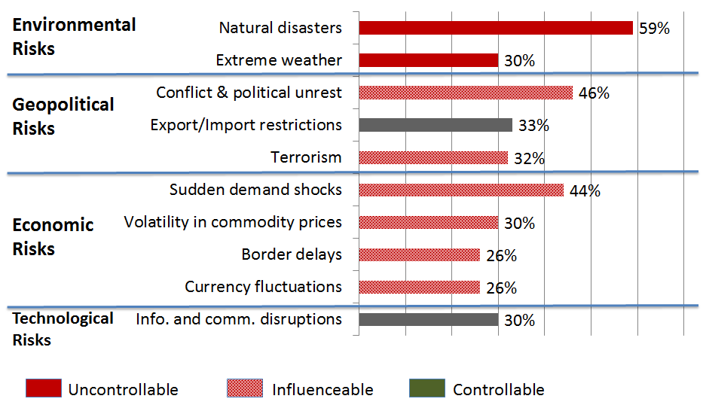
What Worries Supply Chain Executives?
Source: World Economic Forum Supply Chain and Transport Risk Survey, 2011

Slide 18
Disruption How do we Mitigate?
Let’s think about how we begin to mitigate Supply Chain Risk…….

Slide 19
Supply Chain BCM 10 Steps –
Aligned to BS25999
BCM Policy
1
Site has clearly displayed the BCM Policy Statement and has communicated this to all collegues on site. Site has created a Site BCM Scope and Strategy document
Provision of Resource
2
Site has appointed a BCM Champion with appropriate seniority to be accountable for implementing BCM
IMT
3
Site has formed an Incident Management Team with deputies for all key functions
BIA
4
Site has completed the DSC approved BIA document and identified activities that support its key products and services, the MTPD, RTO and its priorities for recovery of its critical activities
BIA Risk Assessment
5
Site has completed the DSC approved BIA Risk Assessment document and has identified and documented the site’s threats
Determining Choices
6
Using the DSC approved Risk Assessment document the site has, for each of its critical activities, identified available risk solutions
Determining BCM Strategy
7
Site has determined how it will recover each critical activity within its recovery time objective, including the resources required for resumption
BCP’s
8
Site to create BCP‘s for all possible risks that could affect critical operations and the BCP‘s are to detail how to manage the incident and how it will recover its activities
Maintaining and Reviewing
9
Site has ensured that it‘s BCM arrangements are reviewed and documented at planned intervals
Testing and Exercising
10
Site IMT has successfully carried out 3 table top exercises in the past 12 months and any lessons learnt have been incorporated into future plans

Slide 20
Vulnerability Factors
Turbulence
Deliberate threats
External pressures
Resource limits
Connectivity
Sensitivity
Natural disasters, geo-political disruptions, fluctuations in currencies and prices, technology failures, pandemics, unpredictable demand
Competitive innovation, social/cultural change, political/regulatory change, price pressures, corporate responsibility, environmental change
Scale of network, reliance on information, degree of outsourcing, reliance upon specialty sources
Source: Pettit, Fiksel, Croxton, Journal of Business Logistics, 2010

Slide 21
Capability Factors
Flexibility in sourcing
Flex. in order fulfillment
Capacity
Efficiency
Visibility
Adaptability
Anticipation
Recovery
Dispersion
Collaboration
Organization
Market position
Security
Financial strength
Part commonality, modular product design, multiple uses, supplier contract flexibility, multiple sources
Reserve capacity, redundancy, backup communication means and energy sources
Collaborative forecasting, customer management, communications, postponement of orders, risk sharing with suppliers
Product differentiation, customer loyalty, market share, brand equity, customer relationships
Source: Pettit, Fiksel, Croxton, Journal of Business Logistics, 2010

Slide 22
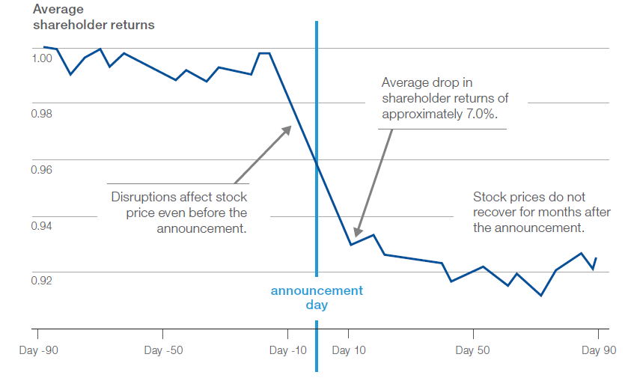
Impact of Supply Chain Disruptions
Average loss of shareholder value = 7%
Source: Accenture analysis of 62 supply chain disruptions publicly announced during 2005-2011

Slide 23
Limitations of Risk Management
Objective Setting
Risks cannot always
be anticipated
Event Identification
Monitoring
Risks may be hard
to quantify
Risk Assessment
Risk Response
Adaptation may be
needed to remain
competitive
COSO Framework for Enterprise Risk Management
Control Activities

Slide 24
Toyota and the Fukushima Disaster (2011)
A devastating earthquake and tsunami crippled Japanese manufacturing, affecting businesses worldwide.
Toyota’s production fell by 63% in Japan and by 30% globally; it took 6 months to return to pre-tsunami levels.
Toyota’s recovery was hampered by flooding in Thailand and the surging yen. Quarterly profits slid by 18.5%.
Source: Industry Week, “How to Build an Anticipatory Supply Chain”, June 2014.

Slide 25
Toyota’s Response
Toyota set out to ensure that recovery from future large-scale disruptions was no more than 2 weeks
    Worked with suppliers to increase visibility
    Spread production across multiple locations
    Increased inventory buffers (lean and agile)
    Redesigned components to standardize across models; increased volumes justify additional manufacturing locations.
Building
Supply Chain Resilience
Source: Industry Week, “How to Build an Anticipatory Supply Chain”, June 2014.

Slide 26
Ex
But Disruptions Don’t Only Happen on the Supply Side…
In March 2013, Walgreens decided to not renew its contract with Cardinal Health. This represented 21% of Cardinal’s revenue.
Cardinal’s stock dropped 8.2% following the announcement.
It put CVS in a good position in their negotiations with Cardinal.
But a year later, “I think it’s noteworthy that we were able to absorb this headwind ... and still grow. We’ve devoted much of the past five years to positioning ourselves to grow in this environment. ... We’ve expanded our customer base and diversified.” – George Barrett, CEO
A year after the disruption the stock had risen 74%.
Source: Steve Wartenberg, The Columbus Dispatch, March 20, 2013 and August 5, 2014

Slide 27
Tools to Assess Risk and Build Resilience
  Supply chain mapping
  Supply chain modeling and simulations
  Risk registers
  Manager surveys
  Business Simulation Exercises
  Table Top Exercises

Slide 28


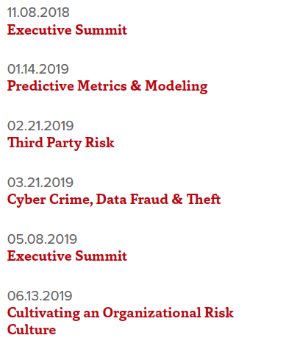
RISK SERIES
RISK SERIES 2018/2019 | RISK SERIES 2019/2020
Upcoming Topics/ Dates to be Announced
Executive Summit: Damage to Brand/Reputation
Cannabis
Product Growth & Distribution
Finance/Banking
HR Issues
Safety/Loss Mitigation
Aging Infrastructure
Impact on Logistics/ Supply Chain
Privacy and spread of 5G Technology
Data Privacy/Data Breach
Weather & Climate Change
Downstream impacts on businesses
Ship technology/new routes opening as a result of climate change
Leading Digital Executive Summit
01.24.2019
Disruptive Innovations & New Technology

Slide 29
Got Questions?

