Slide 1

The New Normal of SCM Talent Management and Labor Issues
Tim McQuade
Senior Director Human Resources
DHL Supply Chain
Brian Devine
Managing Partner
Industrial Workforce Advisors

Slide 2
Agenda
Review national labor stats
Changes in workforce demographics
Demand for supply chain labor
Hourly pay rate tracking
Talent management
Exempt employees
Recommendations

Slide 3
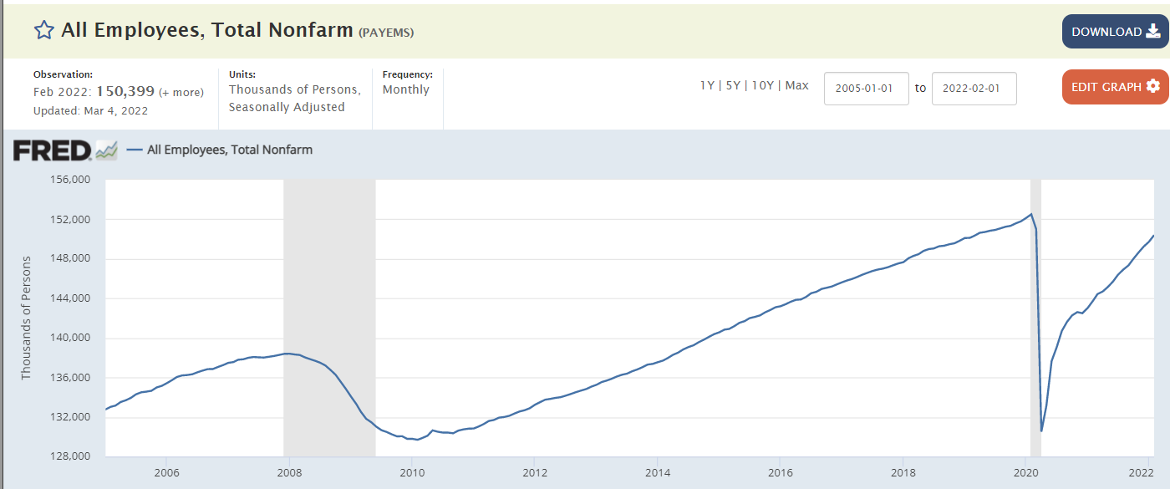
National Stats - BLS
National Unemployment Rate
Feb 2022 = 3.8%
150.4 MM workers
Household survey & Establishment survey
2.1 million fewer workers vs. Feb 2020
11.3 million job openings
(BLS - Last day of Jan 2022)
6.3 million people unemployed (Feb 2022)
Feb 2020
152.5
Feb 2022
150.4
Dec 2007
138.4
+22.8M
Feb 2010
129.7
Apr 2020
130.2
Industrial Workforce Advisors

Slide 4
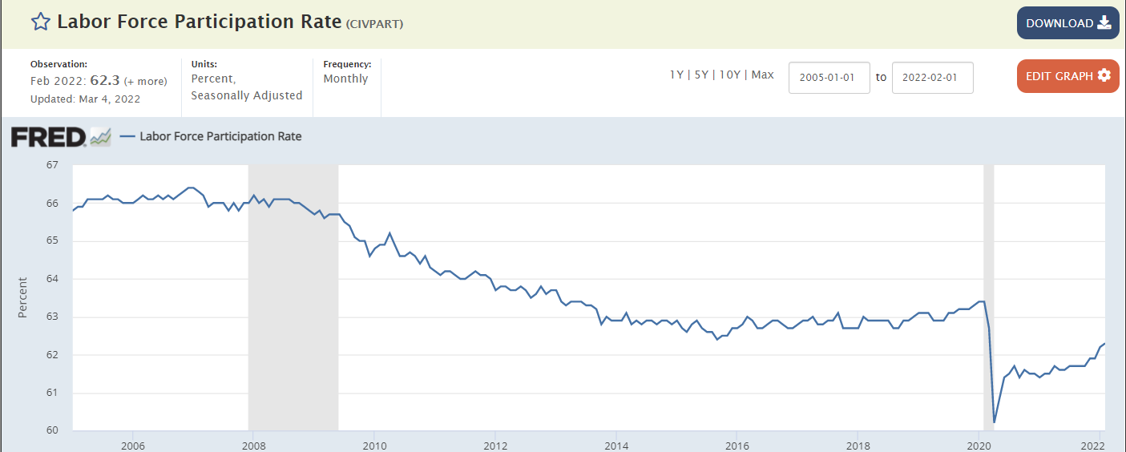
National Stats – Labor Participation Rate
Population 333 million / 262 million over 16 YO
Feb 2022 - 99.6 million
Not in the labor force
54 million over 65 YO
45 million people over 16 not working
Gig-type workers increased by 12.9 million workers (Statista).
Feb ‘22
62.3%
Industrial Workforce Advisors

Slide 5
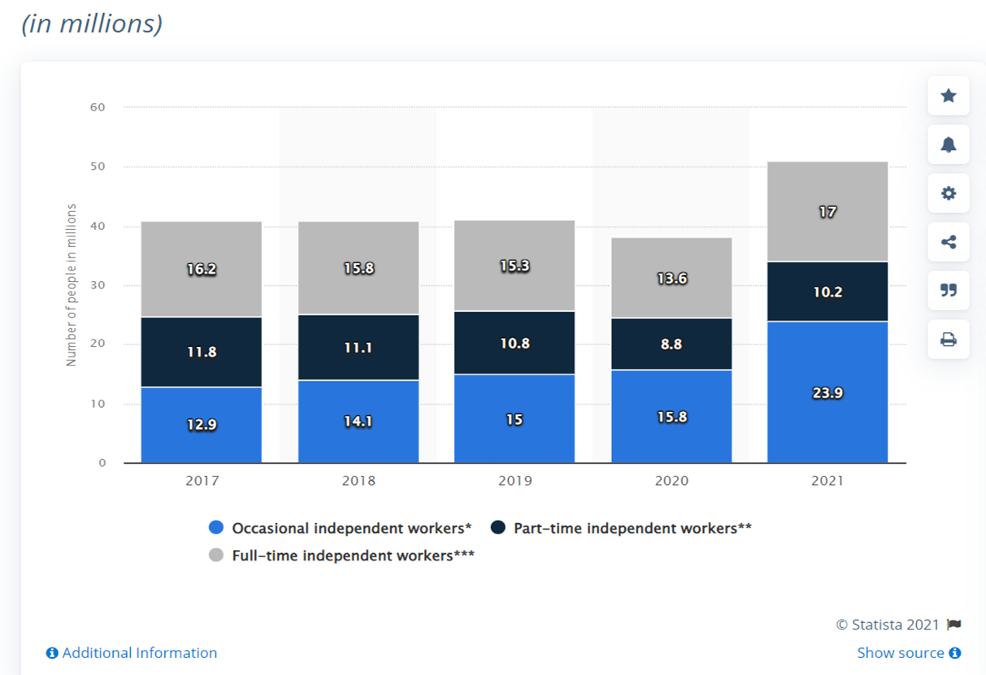
National Stats
12.9 million more “Independent Workers” in 2021 v 2020
GIG Workers
Pew Research Center = 16%
Reuters = 55 MM
Forbes = 55MM
Industrial Workforce Advisors

Slide 6
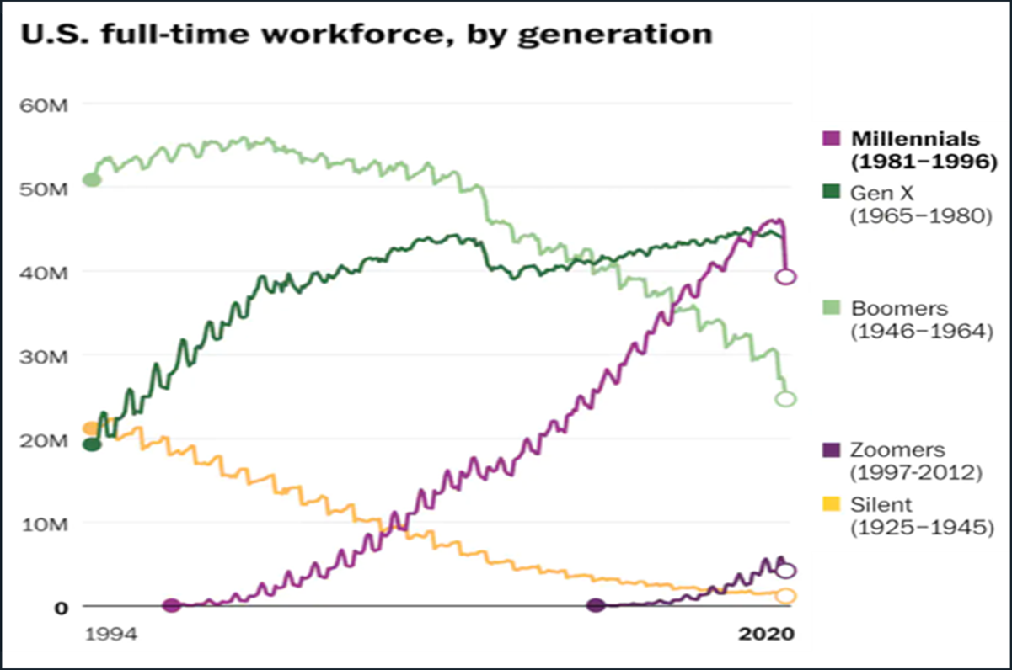
Workforce Demographics
Baby boomers are retiring at a record pace
Millennials are the largest generation in the workforce
Change in the social contract between employer and employee in last 40 to 50 years
Millennials have a different perspective about work-life balance
Industrial Workforce Advisors

Slide 7
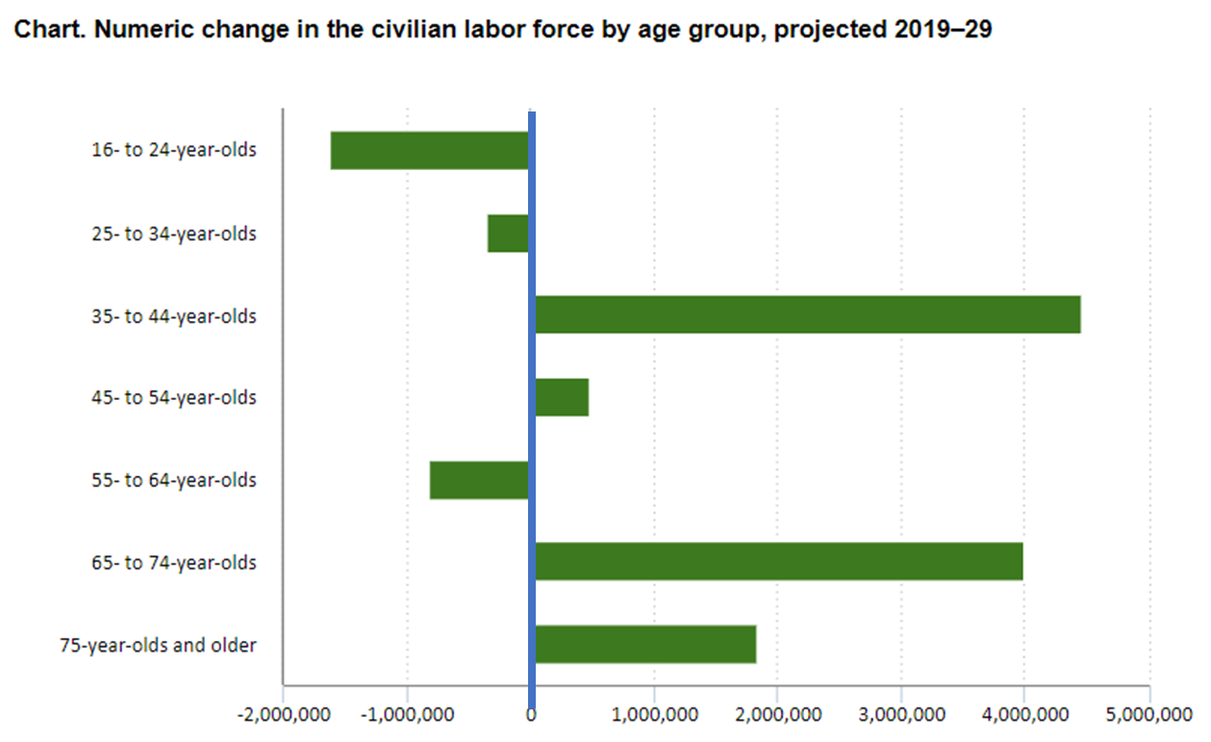
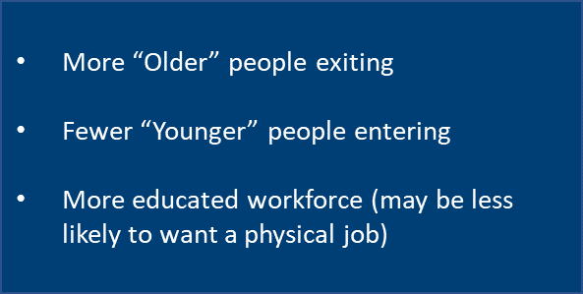
Workforce Demographics
Industrial Workforce Advisors

Slide 8
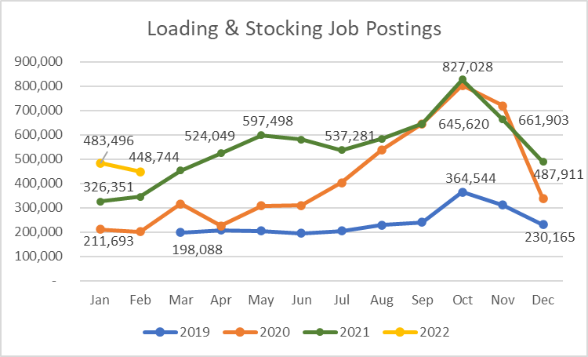
Job Postings – Warehouse - National
2019 – typical year ~200k
Q4 represents the typical retail peak season
2020 saw record growth in warehouse job postings due to shift in consumer trends to e-commerce
2021 saw continued increase in demand for warehouse labor
2022 is starting off at 129% increase in job postings over Jan 2020 (pre-pandemic)
Industrial Workforce Advisors

Slide 9
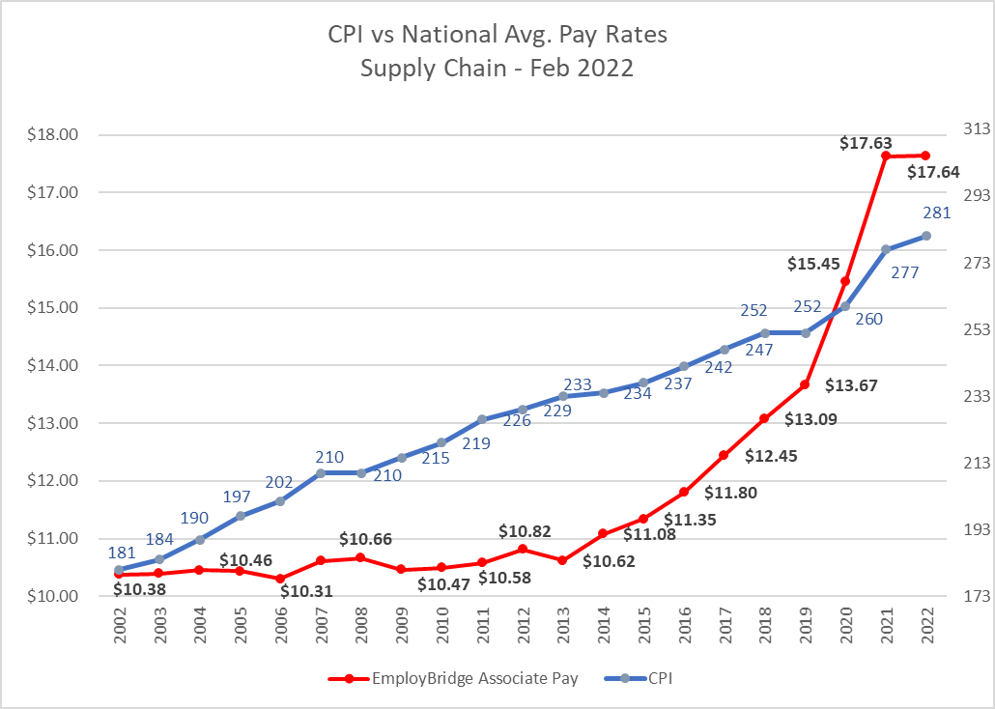


Pay Rates vs. CPI
Logistics jobs peaked at $19.31 per hour in Dec 2021
Logistics jobs
Feb 2022 = $18.50
Manufacturing jobs
Feb 2022 = $17.23
Industrial Workforce Advisors

Slide 10
Talent Management Focus Areas
Greater frequency of career/development conversations, especially with entry level/front line supervisory roles.
Sometimes reinforcing patience/understanding the right career moves.
Relocation for roles is becoming less desirable.
Increase focus on succession planning and talent reviews.
Rapid development of managerial and operational skills.
Roles are becoming available frequently – more stretch/growth assignments.
High competition for talent with supply chain.
Trust but verify organizational tools/process are being effectively utilized and contain quality content/feedback.

Slide 11
Recommendations For Employers
Embrace the facts: Workforce has changed
Employees are driving market
Pay rates must be competitive
Provide some flexibility in schedule / 4 hour shifts
Eliminate mandatory overtime
Review attendance policies
Improve on-boarding experience for new employees
Treat workers with empathy
Industrial Workforce Advisors

Slide 12


Questions
And
Answers
Tim McQuade
tim.mcquade@dhl.com
PH: 717.901.1188
Brian Devine
brian@industrialworkforceadvisors.com
PH: 803-429-8858

