Slide 1


In the New Supply Chain Management Landscape…
You Get the Supply Chain You are Willing to Live With!
Health & Personal Care Logistics Conference
March 15, 2022

Slide 2
Agenda: The New Supply Chain Landscape – Trends and Predictions
The Supply Chain Spectrum
04
Lessons from the Hermit: Have an Outcome-Based Mindset
01
Are we taking our Supply Chain for granted?
02
Building an Outcome-Based Mindset
05
How “Code Red” Conditions are Affecting Supply Chains
Impact and Benefits of an Outcome-Based Mindset
03
06
Notes:
Chad will take this slide

Slide 3
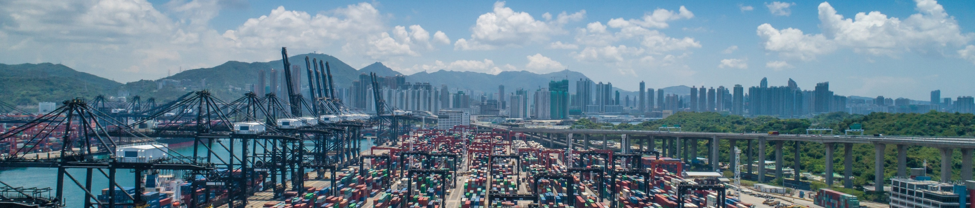
Where is your company on the Supply Chain Spectrum?
The Supply Chain Spectrum encompasses activities associated with:
Procurement / Suppliers & Inventory Strategies / Sales / Customers
Finance / Operational Processes / IT - ERP Systems
Inefficient
World Class
Reactive
Tactical
Siloed
Proactive
Strategic
Holistic
1
2
3
4
5
3
Notes:
Chad

Slide 4
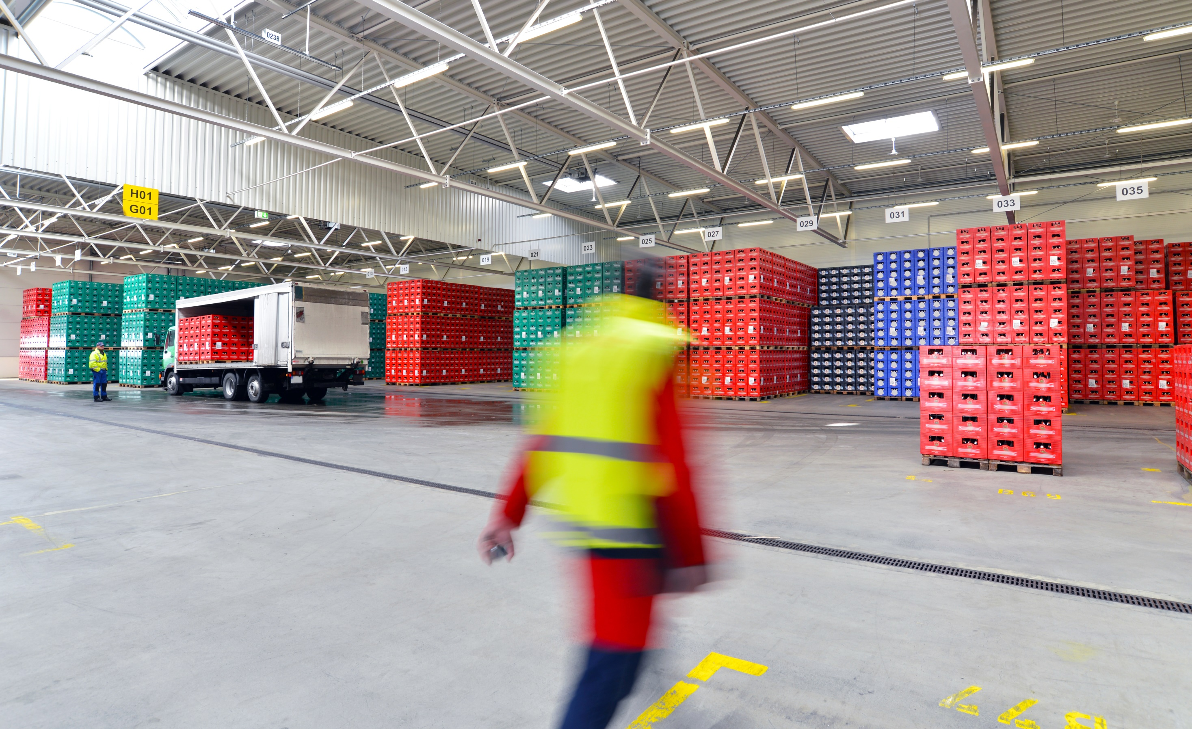
Are You Taking Your Supply Chain For Granted?
Don’t tell me — show me!
4

Slide 5
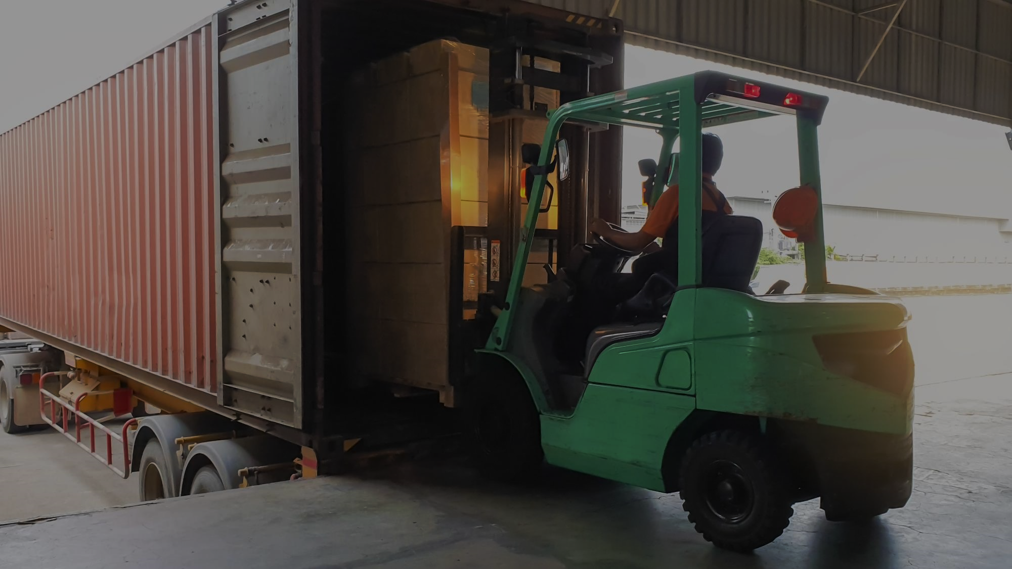
Moving up the SC Spectrum requires we
Start facing the truth!
If our company’s supply chain is:
At risk.
Based on assumptions about customer requirements and supplier capabilities.
Not chaotic. There are patterns we have not yet identified.
Then we need to ask, are we willing to have:
“Dark conversations” dealing with difficult questions
Different dialogues with customers and suppliers
5

Slide 6


How turbulent are “Code Red” conditions in the global freight markets?
6
Notes:
Erick

Slide 7
Ocean Markets
01
Lack of Infrastructure
A Mess with Higher Rates on the Way
01
03
02
02
Driver Shortage
03
Lack of Equipment
A relentless surge in shipping prices and persistent bottlenecks at ports around the world have added to the barrage of problems affecting supply chains.

Slide 8
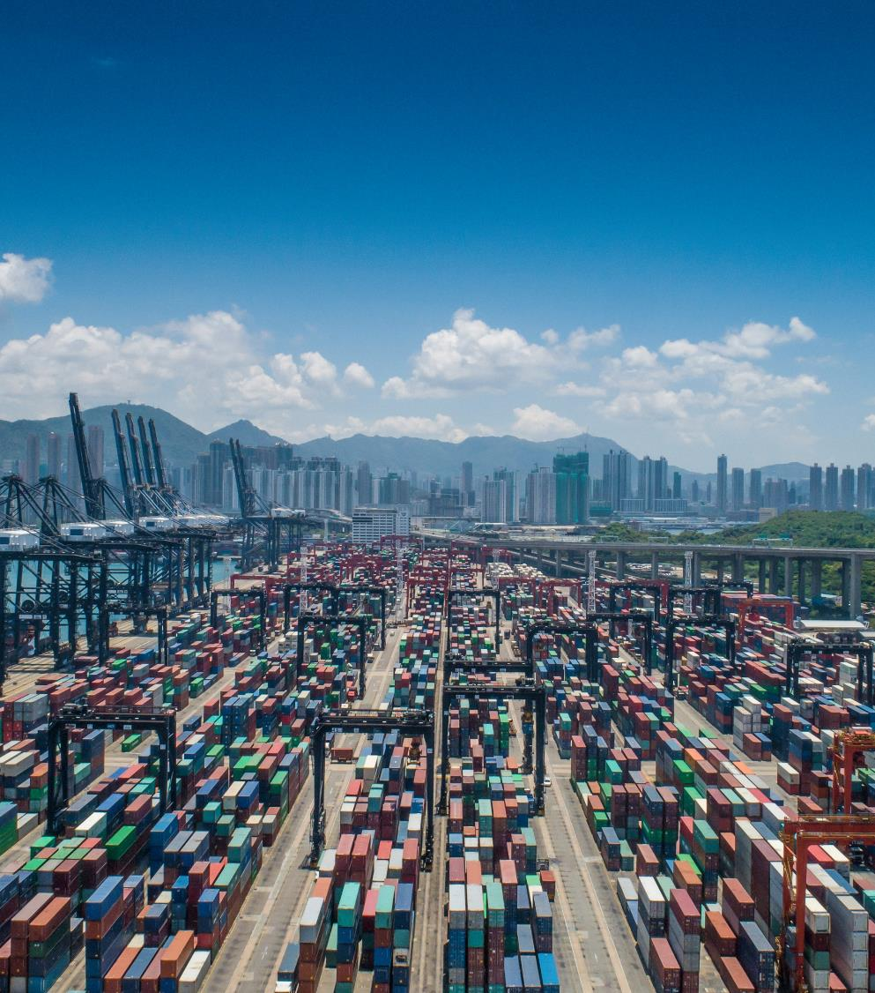
LTL & TL Markets
Higher Rates on the Way
Shippers hoping for trucking rate relief in 2022 are going to be severely disappointed.
The trucking freight market is volatile.
The issues:
Supply and demand
Lack of equipment and drivers
COVID-related issues affecting Warehouse / DC capacity

Slide 9

Parcel Markets
Additional Higher Rates are on the Way
More demand than capacity
Targeted pricing with an emphasis on accessorial charges
Expect parcel costs to increase by 10-12% in 2022

Slide 10

Prediction
Expect the current conditions to persist–and perhaps get even worse—over the next 12 to 18 months.
These are critical issues because the Supply Chain Crisis isn’t going away anytime soon!
Impact of Vaccine Mandates
ILWU Contract up on July 1, 2022
Potential Impact of AB 5 Affecting the Ind. Cont. / Employee Relationship
Historically low inventory numbers results in strong demand well in to 2022

Slide 11
Predictions
How will “Code Red” conditions affect supply chains in 2022
and beyond?
Too much freight/ Not enough capacity
COVID/Employment issues continues to affect
the velocity factor
Need more equipment, drivers and productivity
Slower “circulatory” system equals delays in clearing equipment and reduced capacity
Stressed Supply Chains = Shippers in reactionary mode because they have no:
Written Supply Chain Plan
Clearly defined priorities or awareness of Logistics footprint
Meaningful KPI’s to measure their performance

Slide 12
Playing Under the Bright Lights
Trends
Understanding How Code Red Conditions Affect the 3 P’s of Transportation Logistics and Supply Chains
Pricing - What we Pay
Processes - How we run our business
What % increases get passed on to customers?
Fill rate issues
Carrier sourcing
Meeting customer orders
Practices - How we do things
Reduced predictability impacts inventory sourcing and production schedules
How will reduced predictability impact your sales numbers?

Slide 13

Companies don’t compete. Supply chains compete.
72% of CEOs Worry They'll Lose Their Job in 2022
“The C-suite is a bundle of nerves this winter. A new survey by Alix Partners shows that 72% of chief executive officers are worried about losing their jobs in 2022 because of business disruptions, tracking closely with the 94% of bosses who say their corporate models need to be overhauled within three years….”
“Falling right behind the number one concern of permanent labor shortages, and before the continuation of supply chain disruptions (69%) was worry about CEOs losing their jobs.”
Is your supply chain an asset or a liability?

Slide 14
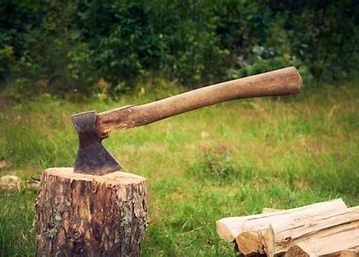
The Importance of Focus in Having an Outcome Mindset
When the Storms Hit:
Lessons Learned from a Hermit
With the early onset of a severe storm, the hermit needed wood.
His Goal: Cut enough wood for the storm.
Distractions Occurred: Given the forecasted severity, he panicked, chopped wood with a dull saw, and ignored sharpening his saw.
Measured activity, not accomplishment: Exhausted, he left plenty of wood uncut.
Notes:
Mike will take this slide

Slide 15
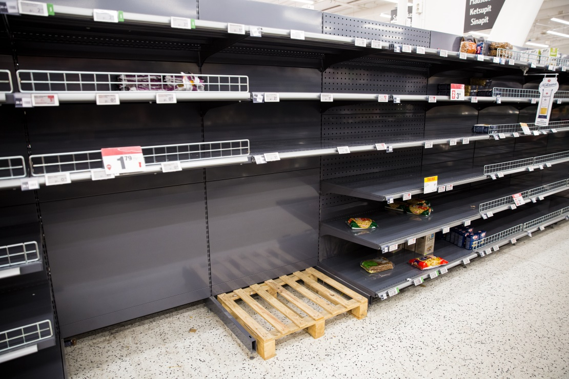
Outcome-Based Mindsets & Collaboration are Critical
01
Extreme turbulence in the transportation sector creates more uncertainty and unpredictability than ever before.
02
The best time to prepare for the storm is before it occurs. You must be able to identify risks and threats that can result in significant operational and sales challenges.
03
Outcome-based supply chains are a competitive advantage that can drive superior operational and financial results.

Slide 16

In a “Code Red” World…
…what outcomes are you focused on?
16

Slide 17

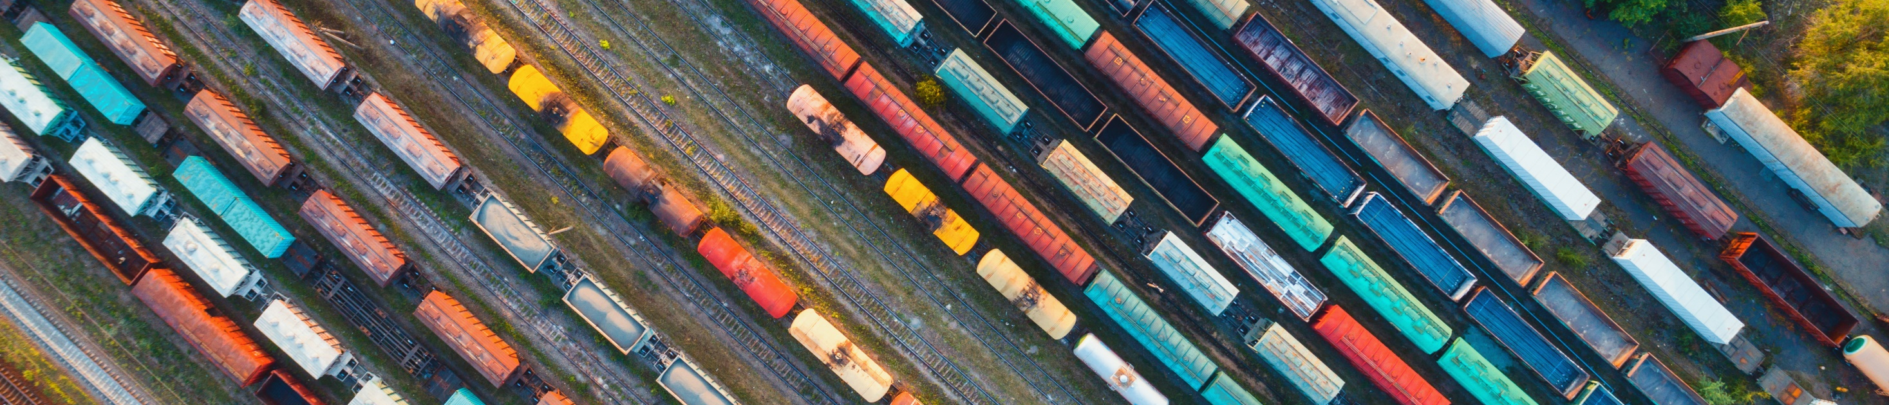
Focus on Outcomes
What will it take to move up the Supply Chain Spectrum?
Current State
Future
State
Inefficient
World Class
Reactive
Tactical
Siloed
Proactive
Strategic
Holistic
1
2
3
4
5
17
Notes:
Chad

Slide 18

Moving up the Supply
Chain Spectrum Requires
01
A Top Down Commitment
There are critical elements that cannot be delegated.
02
Resources (Tools, Technology, People)
Great supply chains cannot be built on the cheap.
03
Experience and Expertise
Make sure the resources are invested in the right areas, addressing the right issues.

Slide 19
Summary
Our rank on the Supply Chain Spectrum
The DNA Issue: Can we shift from being transactional to being strategic?
What will it take to move up the spectrum to get the results that we want?
Are we truly committed?
Determine the “real” ROI on this investment
Outcome-Based Dialogues
Focused on Telling the Truth about our Supply Chain Capabilities

Slide 20
Summary
Clarity!
A Written SC Plan
In a “Code Red” World, where “Severe Storms” are increasingly common, moving up the Supply Chain Spectrum requires…
Focus!
Mapping Your Supply To Identify Risks and Threats
Commitment!
Different Dialogues With Customers and Suppliers amd an emphasis on stratification initiatives

Slide 21

Benefits from Moving up the Supply Chain Spectrum

Slide 22

Mutually Beneficial Outcomes
We Win Together!
01
Predictability
You can’t have lean without a predictable supply chain.
02
Dependability and Reliability
We know who to call and are confident in their ability to consistently produce on our behalf.
03
Accountability
We know who is responsible for achieving desired outcomes.
Turning your Supply Chain from a Liability to a Competitive Asset

